Slide 1
Fiscal Year 2024 (FY24) Annual Report on Sexual Assault in the Military
Department of Defense Sexual Assault Prevention and Response Office (SAPRO)
Providing unparalleled warfighter support, advocacy, and recovery assistance. Anytime. Anywhere.
As of:: 18 April 2025

Slide 2
Overview
Report Contents
FY24 Data
Focus Areas
Preventing Sexual Assault
Enhancing Service member Care and Support
Ensuring Compliance with Policy and Law
Topline Messages
Report Release Activities

Slide 3
Report Contents
Congress requires the Secretary of Defense to provide an Annual Report on Sexual Assault in the Military each April 30 (PL 111-383, Section 1631, and others).
Current reporting requirements include:
Military Department Secretaries’ Annual Reports on sexual assault prevention and response
Sexual assault prevalence and reporting data;
Military justice sexual assault case outcomes; and
Sexual harassment, domestic sexual abuse, and child sexual abuse reports.
Focus areas of this year’s report include:
Preventing Sexual Assault;
Enhancing Service Member Care and Support; and
Ensuring Compliance with Policy and Law.
The Department assesses sexual assault progress via two primary metrics:
Sexual assault prevalence: Estimated number of Service members experiencing unwanted sexual contact measured by scientific surveys; desired state is decrease.
Sexual assault reporting rate: Number of victimized Service members choosing to file Restricted and Unrestricted Reports; desired state is increase.
Both metrics rely on results from the Workplace Experiences Survey of Military Members (WESM)*
This survey was not required or conducted in FY24; therefore, this report does not include a sexual assault prevalence estimate or reporting rate.
DoD will field the WESM in 4th Quarter, FY25 to a representative sample of military members.
*This survey was formerly known as the Workplace and Gender Relations Survey of Military Members. Prior to 2025, Office of People Analytics research products used the term “gender” to describe men and women. These groups were defined using survey items and/or administrative data categories for “male” and “female;” therefore, references to gender should be understood to mean “sex.”

Slide 4
Sexual Assault Prevalence and Reporting
 | 6,973 | Service members who reported sexual assault that occurred during military service
+ | 512 | Service members who reported a sexual assault that occurred prior to military service
+ | 641 | Non-Service members who alleged sexual assault perpetrated by a Service member
+ | 69 | Relevant data not available
 | 8,195 | Total reports of sexual assault received by DoD in FY24
The Department assesses progress with sexual assault via two primary metrics:
Prevalence (i.e., estimated total of Service members experiencing unwanted sexual contact measured by scientific surveys; desired state is decrease.)
Reporting rate (i.e., percentage of victimized Service members making Restricted and Unrestricted Reports; desired state is increase.)

Slide 5
FY24 Sexual Assault Case Outcomes
 | 4,292 | Case Dispositions Reported in FY24
- | 1,059 | Cases Outside DoD Jurisdiction
 | 3,233 | Cases Under DoD Jurisdiction
 | 2,128 | Case Dispositions: Evidence Supported Command Action
- | 748 | Case Dispositions: Evidence Supported Nonsexual Assault Charge
 | 1,380 | Case Dispositions: Evidence Supported Sexual Assault Charge
Sufficient evidence existed to take disciplinary action in 66 percent of cases investigated for sexual assault under DoD jurisdiction in FY24.
Disciplinary action may consist of preferral to court-martial, administration of non-judicial punishment, administrative actions, and administrative discharges.
Court-martial charges were preferred for 31 percent of cases in which evidence supported at least one sexual assault charge
74% of sexual assault court-martial cases ended in a conviction (sexual assault or some other offense); an increase from 72% in FY23

Slide 6
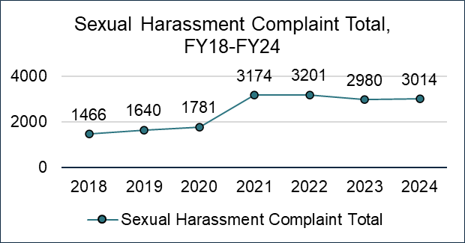
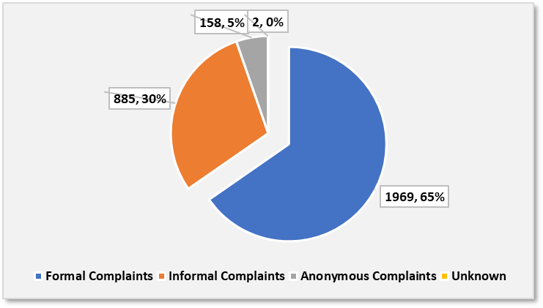
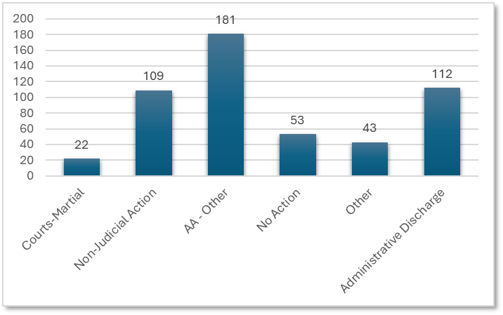
Sexual Harassment Complaints
Total Sexual Harassment Complaint Totals Over the Past Seven Years
Total Sexual Harassment Complaints by Type
There were 3,014 total sexual harassment complaints were filed in FY24
65% (1,969 of 3,014) complaints were formal,
29% (885 of 3,014) complaints were informal,
5% (158 of 3,014) complaints were anonymous,
<1% (2 of 3,014) complaints were unknown
53% of formal complaints were resolved (1,049 of 1,969); 17% pending resolution; and 30% were unknown
59% (624 of 1,049) of resolved formal complaints were substantiated
Offender and Complainant Demographics
Accountability
74% of formal complaints filed by women
The largest single grouping of formal complainants by sex and paygrade were women in paygrades E1-E4 (54 percent)
91% of alleged offenders in formal complaints were men
Enlisted members comprised 86% of offenders in formal complaints
Of the 463 substantiated offenders that received disciplinary action, 63% received adverse or administrative actions, 23% received non-judicial punishment, 9% received other corrective actions
22 (5%) of offenders received a court-martial
No referrals of retaliation associated with sexual harassment were reported in FY24

Slide 7
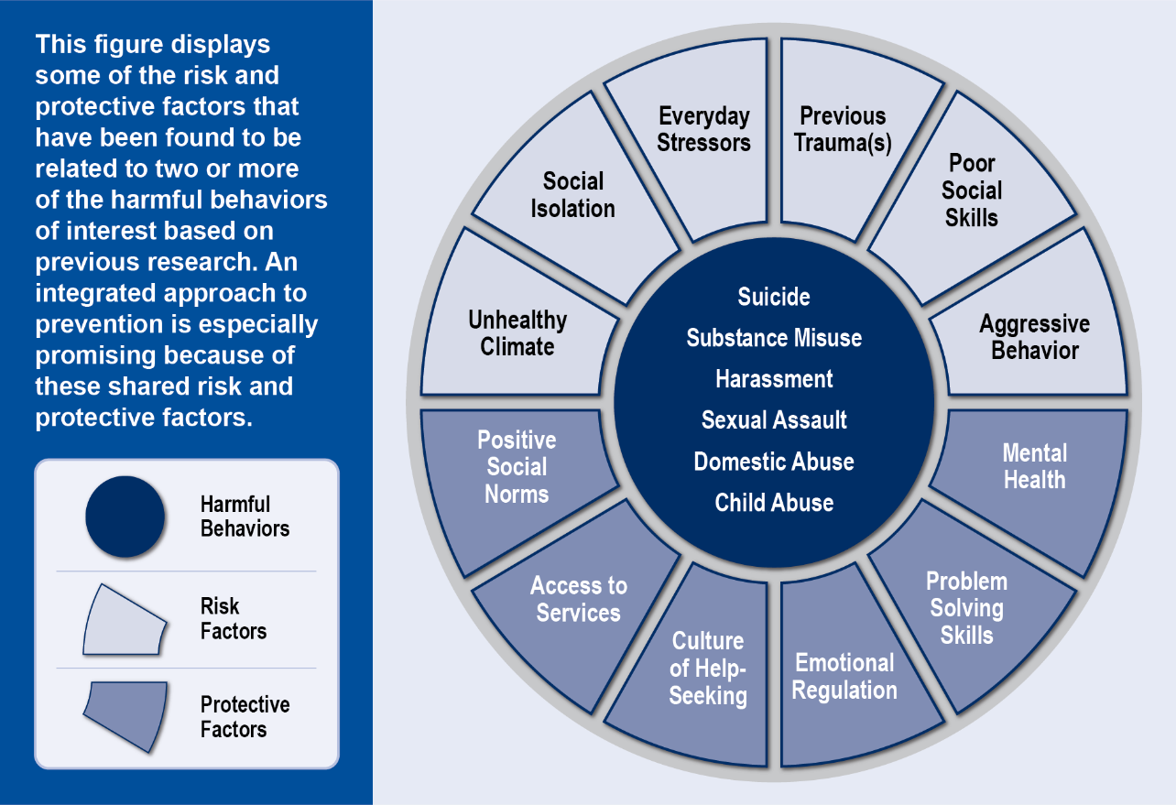
Preventing Sexual Assault
Goal: Reduce the prevalence of sexual assault and other harmful behaviors.
Sexual assault is a key target in the Department’s approach to Integrated Primary Prevention
Key prevention initiatives aim to:
Decrease Risk:
Action: Improve command climate through actionable tools and data
Goal: Decrease sexual harassment and other risk behaviors
Status: Robust Command Climate Assessment policy and infrastructure is empowering local change
Enhance Decision Support for Leaders:
Action: Integrated Primary Prevention Workforce (IPPW) supports leaders at all levels to enhance effectiveness and efficiency of prevention efforts
Goal: Provide commanders at all levels with resources to prevent harmful behaviors
Status: 1,400+ personnel in place, to date
Deliver Proven Prevention That Works:
Action: Evaluate prevention programs and policies; equip the IPPW with effective tools
Goal: Improve effectiveness of prevention activities across the Force, stop ineffective efforts
Status: DoD is delivering training, education, technical assistance and is conducting rigorous evaluations to ensure ROI on prevention efforts
A summary of these initiatives can be found in the 2024 Annual Command Climate Report

Slide 8
Enhancing Service Member Care and Support:
Goal: Deliver high quality assistance and recovery support to Service members.
Improved Service member care and recovery depends on the efficient restructure of the Department’s sexual assault response system.
Key response system initiatives aim to:
Deliver expert Service member care in a complex system:
Action: Continue Sexual Assault Response Workforce Restructuring
Goal: Full-time workforce (2,600) with collateral duty (3400) limited to ships, subs, and hard-to-fill locations
Status: FY27 targets identified and Direct Hire Authority in place but paused due to hiring freeze
Improve Service member recovery and retention:
Action: Develop a recovery program that can be delivered by the Sexual Assault Response Workforce
Goal: Service members learn skills that improve personal and professional outcomes
Status: Launching development in FY25 as a compliment to clinical care.
Workforce restructuring increases full-time expertise and returns thousands of collateral duty manhours to commanders to focus on mission readiness.
Projected benefits to Mission Readiness per two-year certification process:
15,500 fewer background checks
620,000+ fewer hours spent in initial Victim Advocate training (40 hrs)
496,000 fewer hours spent on Continuing Education Units (32 CEUs)
Enhance Capacity and Coping for Special Victim Counsel (SVC)
Action: Revitalize SVC resourcing and training
Goal: Enhance SVC capability to provide quality assistance with resilient staff
Status: Additional investment will sustain victim access and representation worldwide and reduce stresses observed in the system.

Slide 9
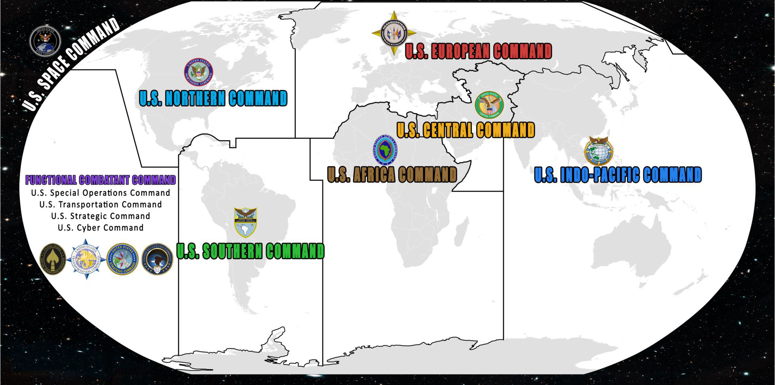
Ensuring Compliance with Policy and Law
Goal: Confirming the SAPR Program benefits Service members as required in policy and law.
Revitalizing existing programs can deliver improved expeditionary mission readiness and justice system participation
Oversight enhancements will:
Enhance Service member care delivery in expeditionary and other joint environments:
Action: Expand Geographic Combatant Command (CCMD) coordination capability
Goal: Establish SAPR Program Administrators in EUCOM, CENTCOM, AFRICOM, & SOUTHCOM to coordinate victim assistance in their area of responsibility
Status: INDOPACOM SAPR PM in place, poised to model improved CCMD and Support Agent collaboration
Improve CATCH a Serial Offender Program participation and efficiency:
Action: Improve case matching automation and ease of participant submissions
Goal: Automate alleged offender search and matching capability while improving rate of submission from victims.
Status: SAPRO and Naval Criminal Investigative Service sustaining program while conducting analysis to identify best means for system improvements

Slide 10
Key Points
Warfighter ethos values respect for one's comrades in arms. Sexual assault and sexual harassment detracts from our mission.
The Department’s commitment to Service member recovery post sexual assault is a critical part of maintaining a strong, lethal, and prepared military.
Integrated Primary Prevention initiatives provide commanders with effective means to counter sexual assault and other problems that erode operational capability within their units.
The reforms to the Sexual Assault Response Workforce align with the Secretary’s direction to restore our military, ensuring that Service members are left unencumbered to execute their mission.
The Department will continue to invest in full-time experts to deliver the greatest share of Service member assistance and recovery and leverage collateral duty support in remote and hard to fill locations.
When made common practice worldwide, the best practices observed in expeditionary environments will deliver the means to better coordinate resources, improve connections to care, and assist Service members – anytime, anywhere.
The Department remains fully committed to sexual assault prevention and response.
We take decisive action to identify challenges facing our policy and programs, apply meaningful solutions, and made good on our commitment to Service member safety, assistance, and recovery.

